Slide 1
Digital Portfolio
E.Janani
STUDENT NAME:
REGISTER NO AND NMID:
DEPARTMENT:
COLLEGE:
C1F0CB62F78FD33879F45D2F78FE3AD8
Bsc Computer Science
Immaculate college for women /Annamalai

Slide 2
PROJECT TITLE
PERSONAL PORTFOLIO WEBSITE

Slide 3


AGENDA
Problem Statement
Project Overview
End Users
Tools and Technologies
Portfolio design and Layout
Features and Functionality
Results and Screenshots
Conclusion
Github Link
3/21/2024 Annual Review

Slide 4

PROBLEM STATEMENT
Problem Statement:
Many professionals, freelancers, and creatives struggle to effectively showcase their skills, projects, and personal brand online. Traditional resumes and LinkedIn profiles often fail to capture an individual’s unique personality, style, and full range of capabilities. As a result, potential employers, clients, or collaborators may overlook talented individuals simply because their work and achievements are not presented in an engaging or accessible manner.

Slide 5

PROJECT OVERVIEW
Personal Portfolio Website Overview:
A personal portfolio website is a digital platform that showcases an individual’s professional skills, projects, achievements, and personal brand. It serves as an interactive resume and a creative space to present work to potential employers, clients, or collaborators.
Key Features:
About Me: Introduces the individual, their background, and professional philosophy.
Portfolio/Projects: Displays completed work with descriptions, images, or links.
Skills & Expertise: Highlights technical, creative, and professional sKill

Slide 6

WHO ARE THE END USERS?
Potential Employers or Recruiters
Clients or Customers (for freelancers, designers, developers)
Collaborators or Partners
Peers and Community Member
General Public / Audiance.

Slide 7

TOOLS AND TECHNIQUES
1. Design Tools
These help plan the layout, aesthetics, and user experience:
Figma / Adobe XD / Sketch – For wireframing, UI/UX design, and prototyping.
Codepen– For creating graphics,for code pen
HTML5 – Structure of web pages.
CSS3 / SASS / Tailwind CSS – Styling and responsive design.
JavaScript / TypeScript – Interactivity and dynamic content.
React / Vue.js / Angular – Modern frameworks for building interactive UIs
4. Content Management & Portfolio Builders
WordPress / Webflow / Wix / Squarespace – Drag-and-drop website builders for non-coders.
Notion / Carrd – Lightweight portfolio hosting platforms.

Slide 8
POTFOLIO DESIGN AND LAYOUT
1. Design Principles
Simplicity: Keep layouts clean; avoid clutter.
Consistency: Use a consistent color scheme, typography, and spacing
2. Common Layout Structure
A typical portfolio website can follow this flow:
Header / Navigation
Logo or name
Menu links (About, Portfolio, Skills, Contact)
Hero Section / Introduction
Short introduction or tagline
Profile picture or creative graphic
Call-t
About Me
Skills summary (technical, creative, soft skills)
Portfolio / Projects Section
Showcase work with images, descriptions, and link
8

Slide 9
FEATURES AND FUNCTIONALITY
1. Homepage / Landing Page
Hero Section: Eye-catching introduction with your name, title, and a short tagline.
Profile Picture / Background: Optional animation or professional photo.
Call-to-Action (CTA): Buttons like “View My Work” or “Contact Me.”
2. About Me Section
Personal Bio: Brief background, skills, and experience.
Key Achievements: Highlight awards, certifications, or notable projects.
Downloadable Resume: Optional PDF download link.
Fun Facts / Personal Touch: Optional to humanize your profile.
4. Skills Section
Technical Skills: Programming languages, software, tools.
Proficiency Levels: Bars, percentages, or star ratings.
Soft Skills: Communication, teamwork, leadership (optional).

Slide 10
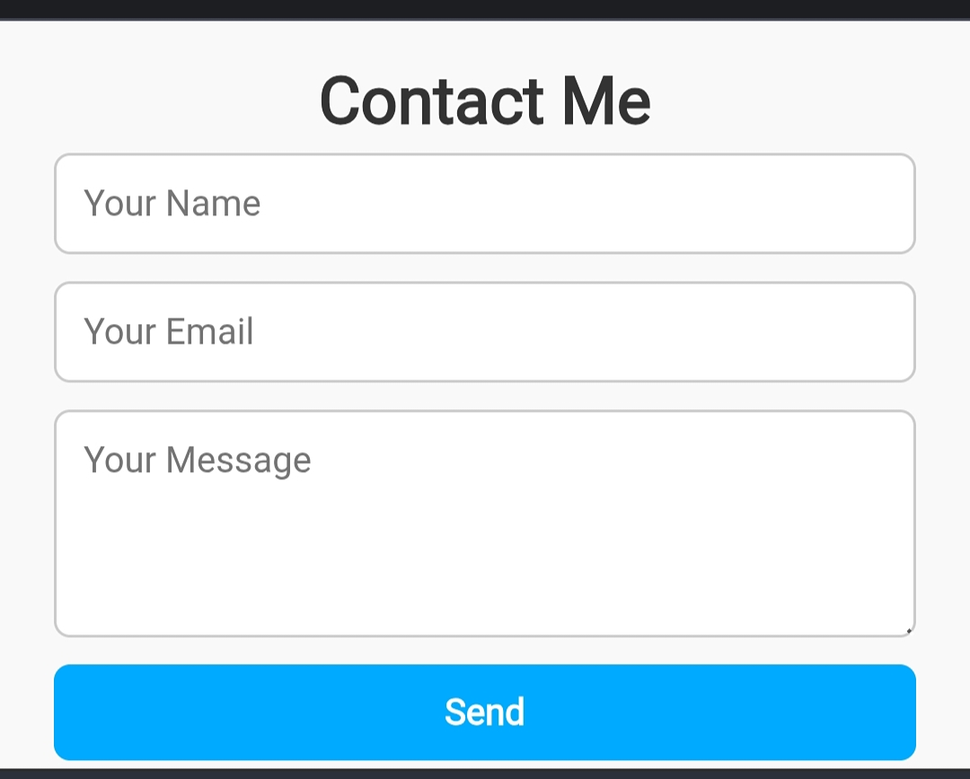

RESULTS AND SCREENSHOTS
3/21/2024 Annual Review
10

Slide 11
CONCLUSION
Conclusion
A personal portfolio website serves as a dynamic representation of your skills, achievements, and professional identity. It not only showcases your work and expertise but also provides a platform to communicate your personal brand effectively to potential clients, employers, or collaborators.
By combining a visually appealing design with interactive features, clear navigation, and essential information such as projects, skills, and contact details, a portfolio website enhances your credibility and makes it easier for others to connect with you.
11

